Slide 1


Slide 2


Welcome to .NET Conf: Focus on MAUI
David Ortinau, Principal PM
@davidortinau
Maddy Montaquila, Senior PM
@maddymontaquila
Notes:
3-5 – David
6-8 – Maddy
9-12 – David
13-17 – Maddy
18-24 – David
25-29 – Maddy
30-34 – David

Slide 3

Client app development is important
>1B
Windows 10 & 11 devices worldwide
>4B
iPhone & Android devices worldwide
Sources: blog.google/products/android/android-12-beta/ ; www.imore.com/apple-earnings-call-transcripts-q1-2021 ;
Notes:
There are A LOT of desktop and mobile devices in the world. There are over 1 billion Windows 10 and 11 devices worldwide and over 4 billion iPhone and Android devices. And those numbers will keep on growing with estimated consumer purchases.
Regardless if you are a web developer or a native app developer, you want to reach the most client devices possible with great user experiences in the most efficient way possible.

Slide 4
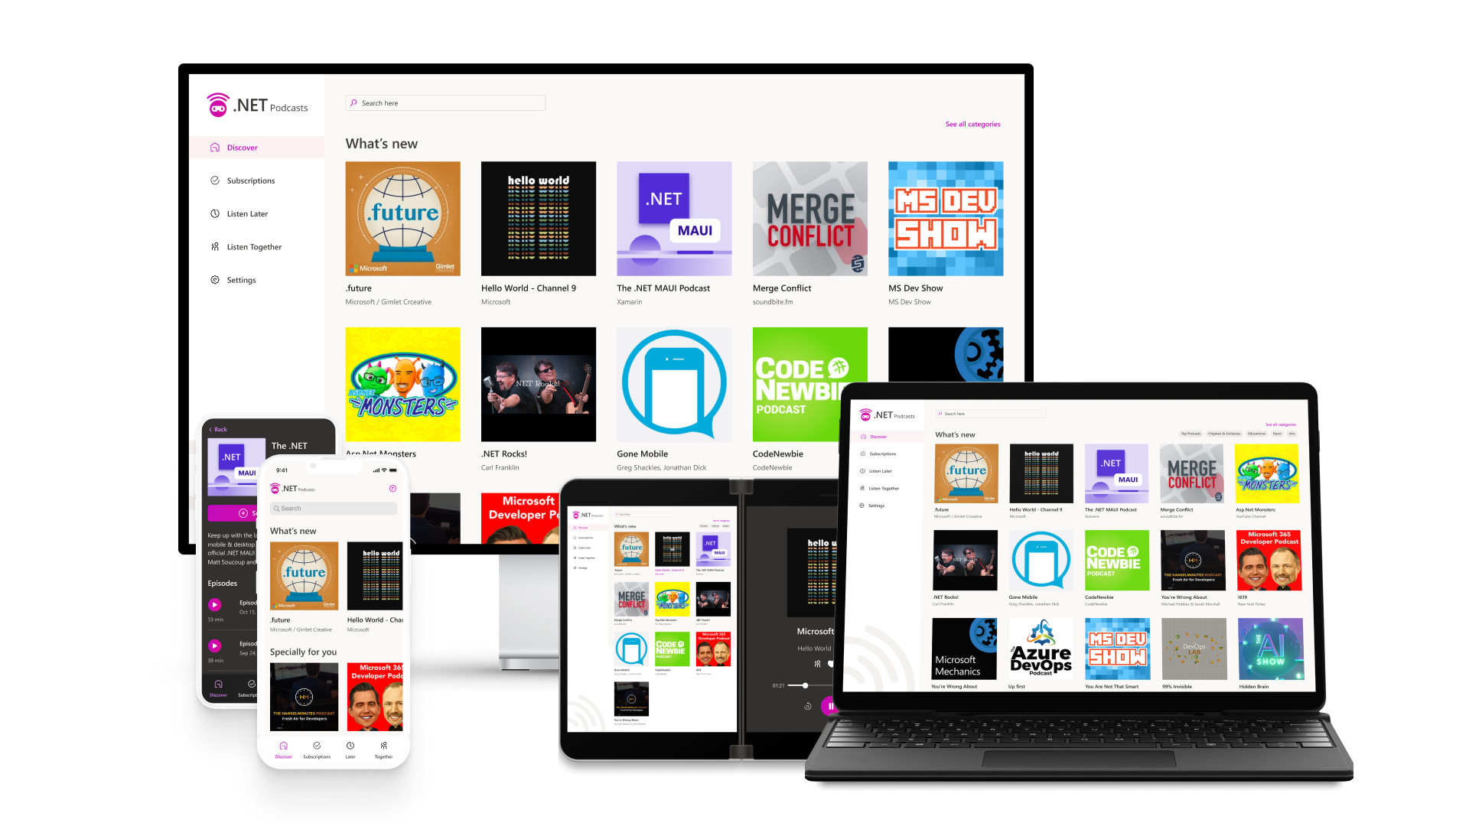
.NET Multi-platform App UI is the most productive way to develop native apps with a single codebase that perform great on any consumer device.
Sources: blog.google/products/android/android-12-beta/ ; www.imore.com/apple-earnings-call-transcripts-q1-2021 ;
Notes:
In order to reach all of these devices with beautiful app experiences, we built .NET MAUI to be the most productive way to develop native apps with a single codebase that perform great on any device. Instead of learning different stacks and languages for each device, you can use one language, one set of libraries, and one UI stack for all of them.
APIs are available directly from C# to access over 60 device platform features including things like isolated storage, sensors, geolocation, camera, and more. Use one programming language, one codebase, and one project system for all device targets with support for cross-platform resources including images, icons, splash screens, and more. .NET MAUI on Windows supports WinUI allowing these apps to use all the newest native features on supported versions of Windows 10 and 11.

Slide 5


.NET MAUI in .NET 6
One Base Class Library
Type Unification
CLI Support
SDK Style Projects
Modern Support Lifecycle
Unified .NET
.NET 6
.NET MAUI
Mobile, desktop, hybrid
Android
iOS
WinUI
Mac Catalyst
Blazor WebView
WinUI
Mac
Catalyst
iOS
Android
Single Project
Microsoft.Extensions
.NET Hot Reload
XAML Hot Reload
Visual Diagnostics
Productive development
macOS
iOS
Notes:
.NET MAUI is built on .NET 6, so that means that you get a single, unified .NET experience across workloads and project types. There is one base class library and unified type system with CLI support.
.NET MAUI under the hood uses technologies out there today for building native apps on Windows with WinUI, Mac Catalyst for macOS, and of course, iOS and Android. .NET MAUI abstracts all those frameworks into a single framework built on .NET 6.
.NET MAUI lets web developers build hybrid web apps too. Share Blazor web components directly in .NET MAUI apps while having access to native device capabilities and packaging. By using .NET MAUI and Blazor together, you can reuse one set of web UI components across mobile, desktop, and web.
Visual Studio 2022 includes Hot Reload technology to make you much more productive building .NET MAUI apps. Type code, hit save, and see the changes right away. You can also take advantage of the latest debugging, IntelliSense, and testing features of Visual Studio to write better code faster.

Slide 6
.NET Multi-platform App UI
Today Visual Studio 2022 17.3 released with .NET MAUI tools
.NET MAUI SDK released in May
Visual Studio for Mac tools will release in 17.4
Update to Visual Studio 2022 17.3 from the Visual Studio Release Channel
visualstudio.com/download
Notes:
[M]We’re so excited to get Visual Studio 2022 17.3 ,Windows out the door TODAY with MAUI tooling now generally available in the release channel.
The release will go live shortly after the keynote ends – get ready to update!
Visual Studio for Mac developers, we have some exciting updates for you as well later in this session!

Slide 7
.NET Adoption
1.7x
126%
>5M total
Notes:
[M] Like David said, .NET MAUI is just part of .NET – and .NET is growing! In fact, .NET 6 was adopted at nearly twice the rate of .NET 5, and .NET 7 comes out this November! Even with tooling in preview, we have seen HUGE usage and growth of MAUI since we released the SDK, and we are super grateful for all of the apps and blogs and videos and feedback you’ve shipped so far.

Slide 8
.NET MAUI perf improvements
68%
Faster than Xamarin.Android
44%
Faster than Xamarin.Forms
Notes:
[M] MAUI is also super fast. If you’re coming from Xamarin, you’re going to see huge performance improvements in your app startup and more. If you’re new to cross platform .NET development, you’ll be amazed at just how speedy it is!

Slide 9











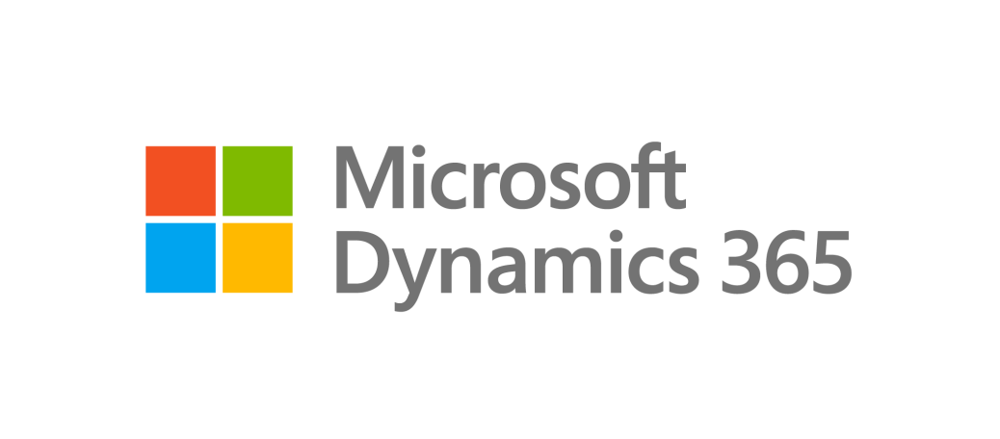









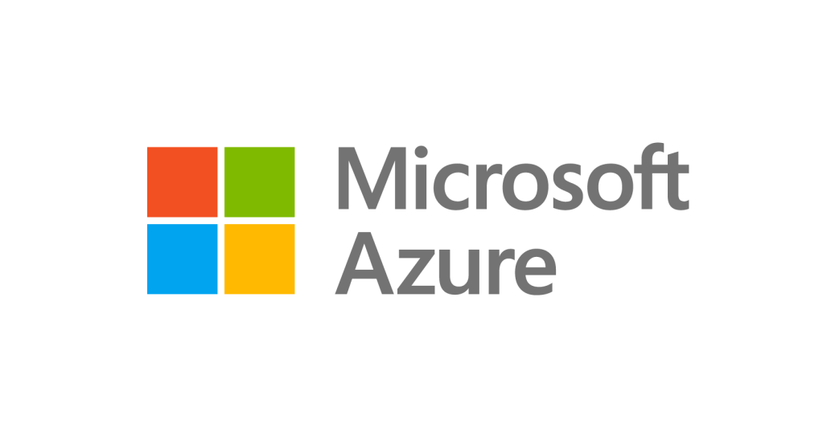


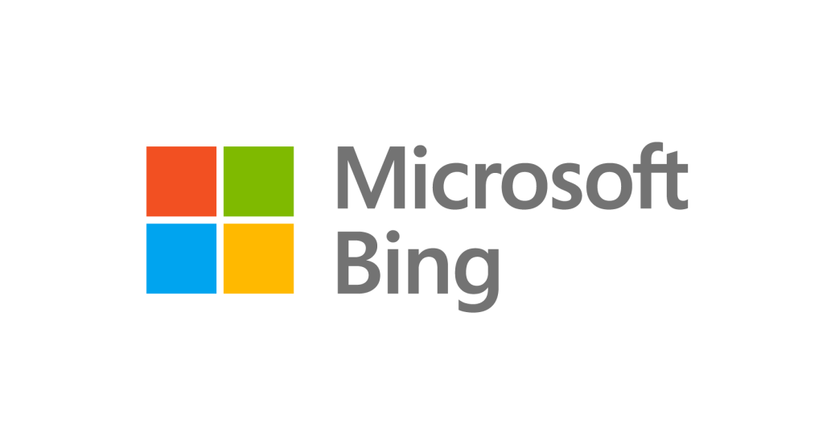











Notes:
Amazing developers like you have built incredible software with .NET for millions of companies around the world, in every industry. They rely on and trust the .NET platform, some of them for over 20 years. Here’s just a few.
.NET MAUI builds on top of the .NET platform, and we’re excited to see existing and new companies starting to adopt .NET MAUI.

Slide 10

Pronto Pay
“We chose to go into production with .NET MAUI because as a startup, we need to move fast and want be on the cutting edge of tech.
We love the simplicity of a single code-base and the usability on iOS, Android, macOS, and Windows.
And with the ease of deployment built into Visual Studio, we had a tool that allowed us to build a product that was dependable for our customers, yet nimble enough to continue growth with a startup team.”
- Jeff Price, Founder & CEO
Technologies used
Azure, .NET MAUI, Blazor, GitHub, Visual Studio
Notes:
Pronto Pay is a startup based in Houston Texas that chose to go into production with .NET MAUI because they needed to move fast. They love the simplicity of a single code-base that they can build to target multiple devices and the productivity of Visual Studio.

Slide 11
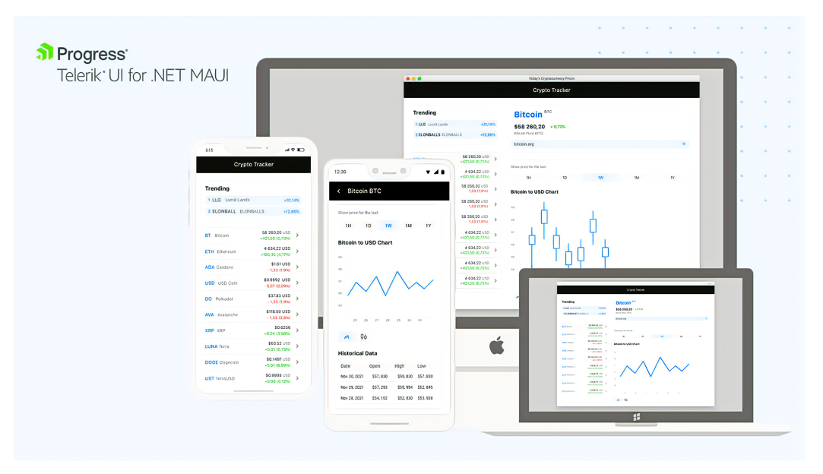
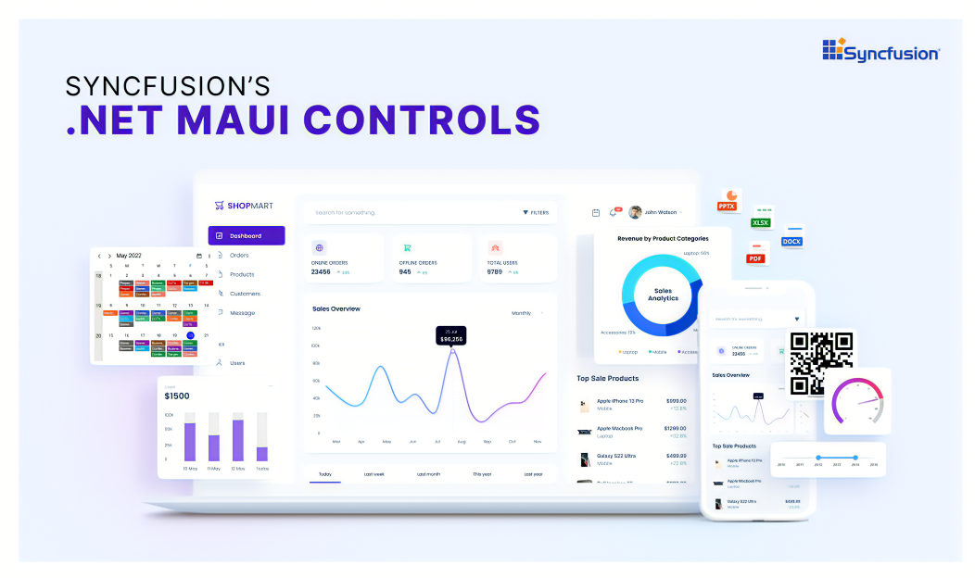
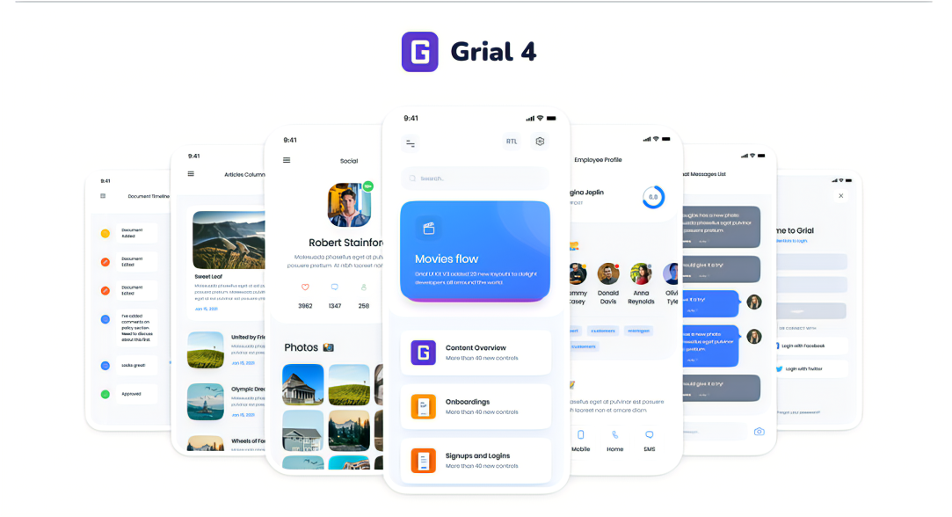

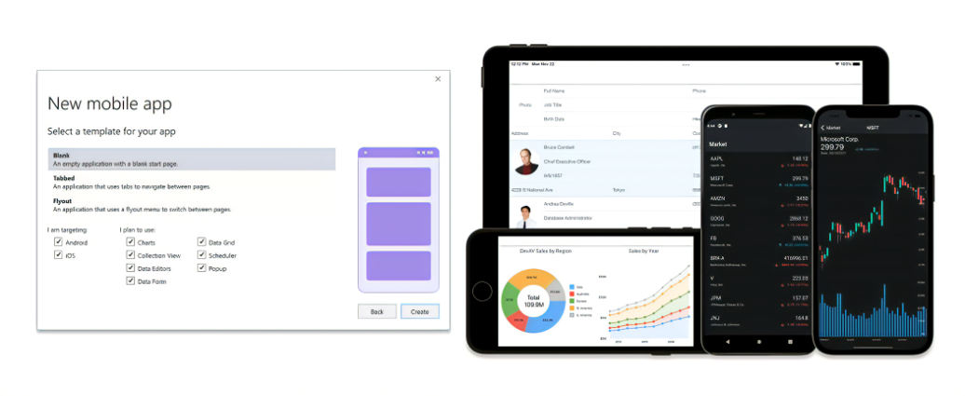



Controls, components, plugins, libraries and more…
AndroidX AlohaKit CommunityToolkit.MVVM CommunityToolkit.Maui CommunityToolkit MauiCompat CommunityToolkit Markup.MauiCompat DevExpress Facebook FreshMvvm.Maui Google APIs for iOS | Google Play Services Client Libraries GrialKit MauiAnimation Microsoft.Maui.Graphics MR.Gestures MSAL Prism.Maui Plugin.Fingerprint Plugin.InAppBilling Plugin.StoreReview | Plugin.ValidationRules Progress Telerik UI for .NET MAUI ReactiveUI.Maui Realm by MongoDB Sentry Shiny SkiaSharp & Skottie Syncfusion .NET MAUI Controls TemplateUI User Dialogs

Slide 12

THANK YOU!
Notes:
A HUGE thank you everyone who made these incredible contributions to the .NET MAUI ecosystem!
<pause and clap your hands>

Slide 13

Productive
Visual Studio 2022 + .NET MAUI = Build apps faster.
Notes:
[M] 10 min
At the heart of .NET MAUI is you – our developers – and your productivity. Whether this is your first or five millionth time opening a MAUI project, you’ll benefit from a robust suite of tooling made to get you building your beautiful apps faster.

Slide 14
Visual Studio 2022 productivity
Intelligent code editing
AI-assisted development
Live Share remote collaboration
C#, XAML, Razor IntelliSense
Rapid iteration
Hot reload XAML, C#, Razor, CSS, and more
Preview and Inspect UI at debug time
Develop for anything, anywhere
Use Android emulators, devices, or WSA
Develop iOS directly from Windows
Use iOS simulators via Xcode
Visual Studio for Mac and Windows
Notes:
[M]

Slide 15
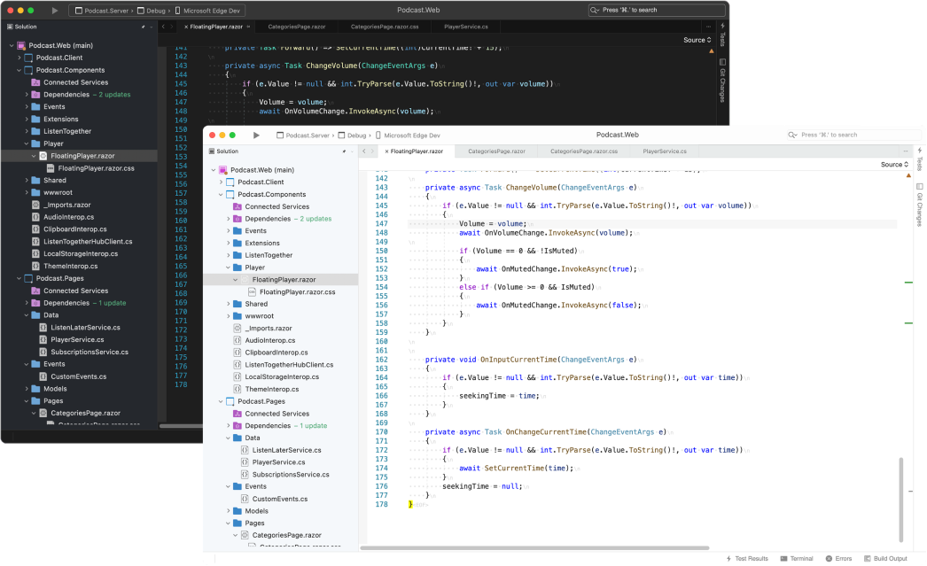
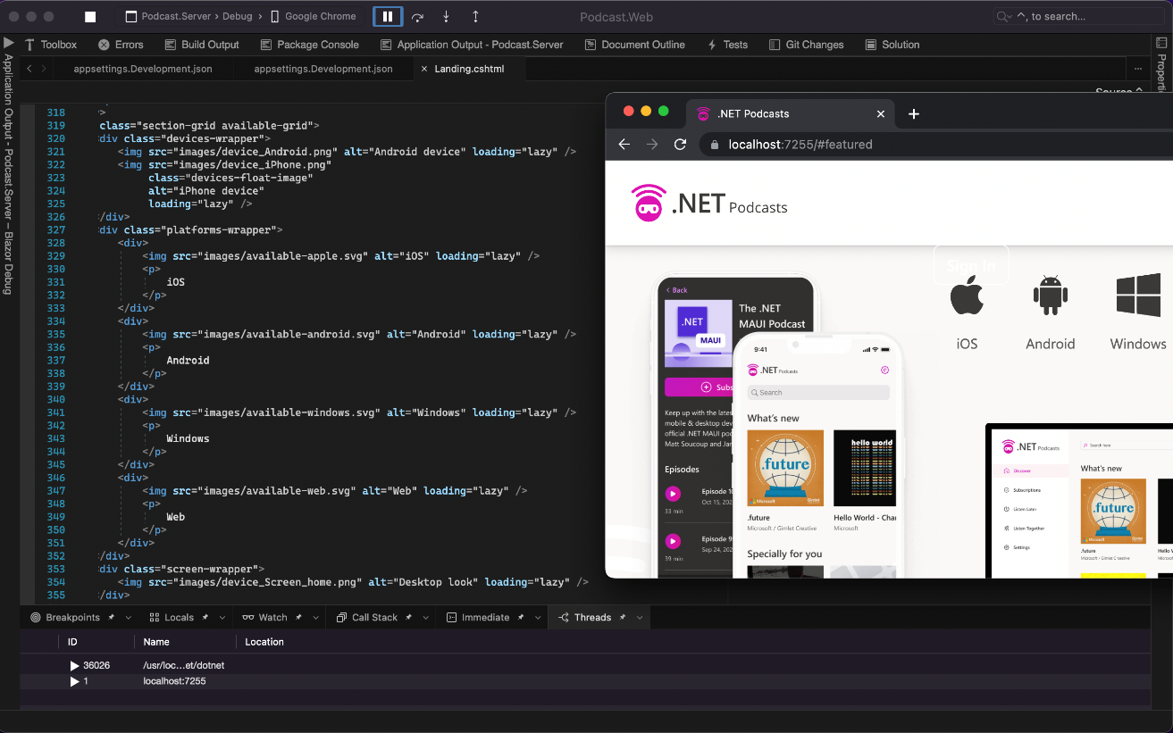
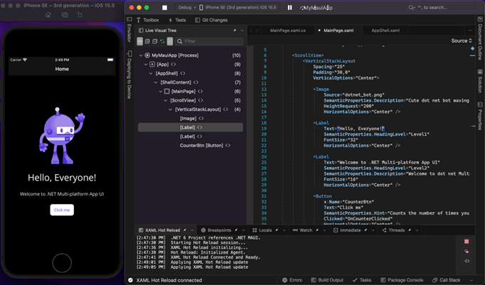
Visual Studio 2022 for Mac
Fast & fluid IDE
Fully native macOS UI
Native support for Apple M1
Built on .NET 6
Modern .NET 6 development
Native iOS, macOS & Android apps
Responsive web UIs
Web, cloud, & container development
Integrated Tools
Hot reload XAML and live update UI
Fast deploy to iOS simulators & Android emulators
Powerful debugging, refactoring, IntelliSense
Notes:
[M]

Slide 16
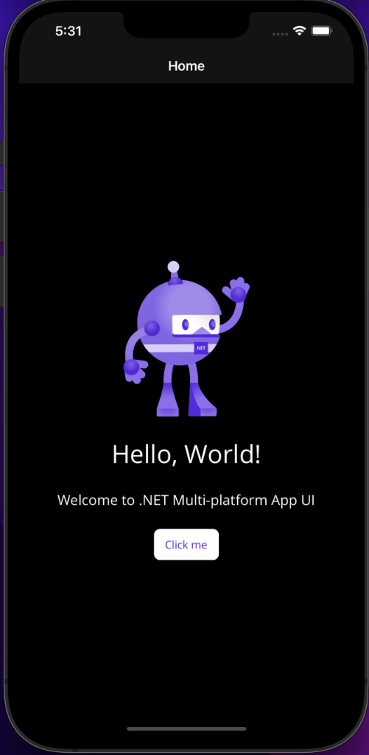
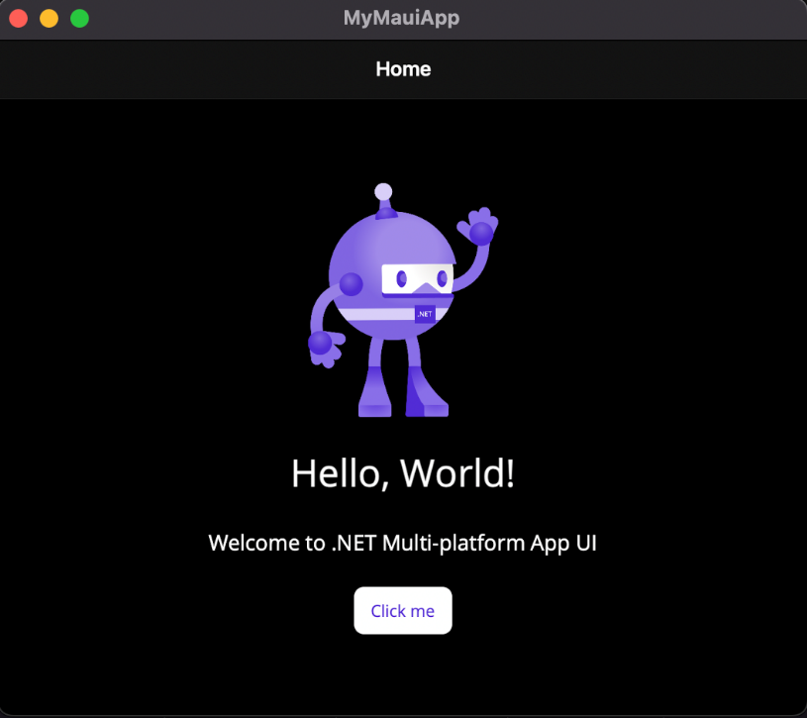
One codebase, single project, multi target
Notes:
[M]

Slide 17
Demo
.NET MAUI Productivity
Notes:
[M]
Walk through, project system, tools HR
Windows + Android
end of demo = 25mn = 8:25

Slide 18

Native
Platform experiences are the best experiences.
Notes:
Let’s turn it back over to David to see just how native .NET MAUI is!

Slide 19



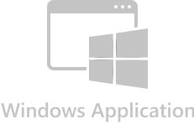
Native
android.widget
AndroidX libraries
Java/Kotlin APIs
UIKit
ARKit, AVKit, CarPlay, and dozens more
Obj-C/Swift APIs
Mac Catalyst
UIKit + AppKit
Dozens of frameworks
Obj-C/Swift APIs
Windows App SDK
WinUI 3
C++ APIs

Slide 20
What’s “in the box” and nearby?
Features
MVVM & XAML
Android, iOS, macOS, Windows
7 Layouts
44 Views
Maui.Essentials
Maui.Graphics
Xamarin.Forms Compat
CommunityToolkit.
Maui
Maui.Markup
Mvvm
New Capabilities
BlazorWebView
Border
Shadows
GraphicsView
MenuBar
Window/Multi-Window
Default theme
AppIcon
SplashScreen
Fonts
Images
Shell flyout templates
Changes from Xamarin
Color/Colors
Zero’d defaults
Namespace
More XAMLC
App Startup
Lifecycle Events
.NET workloads

Slide 21
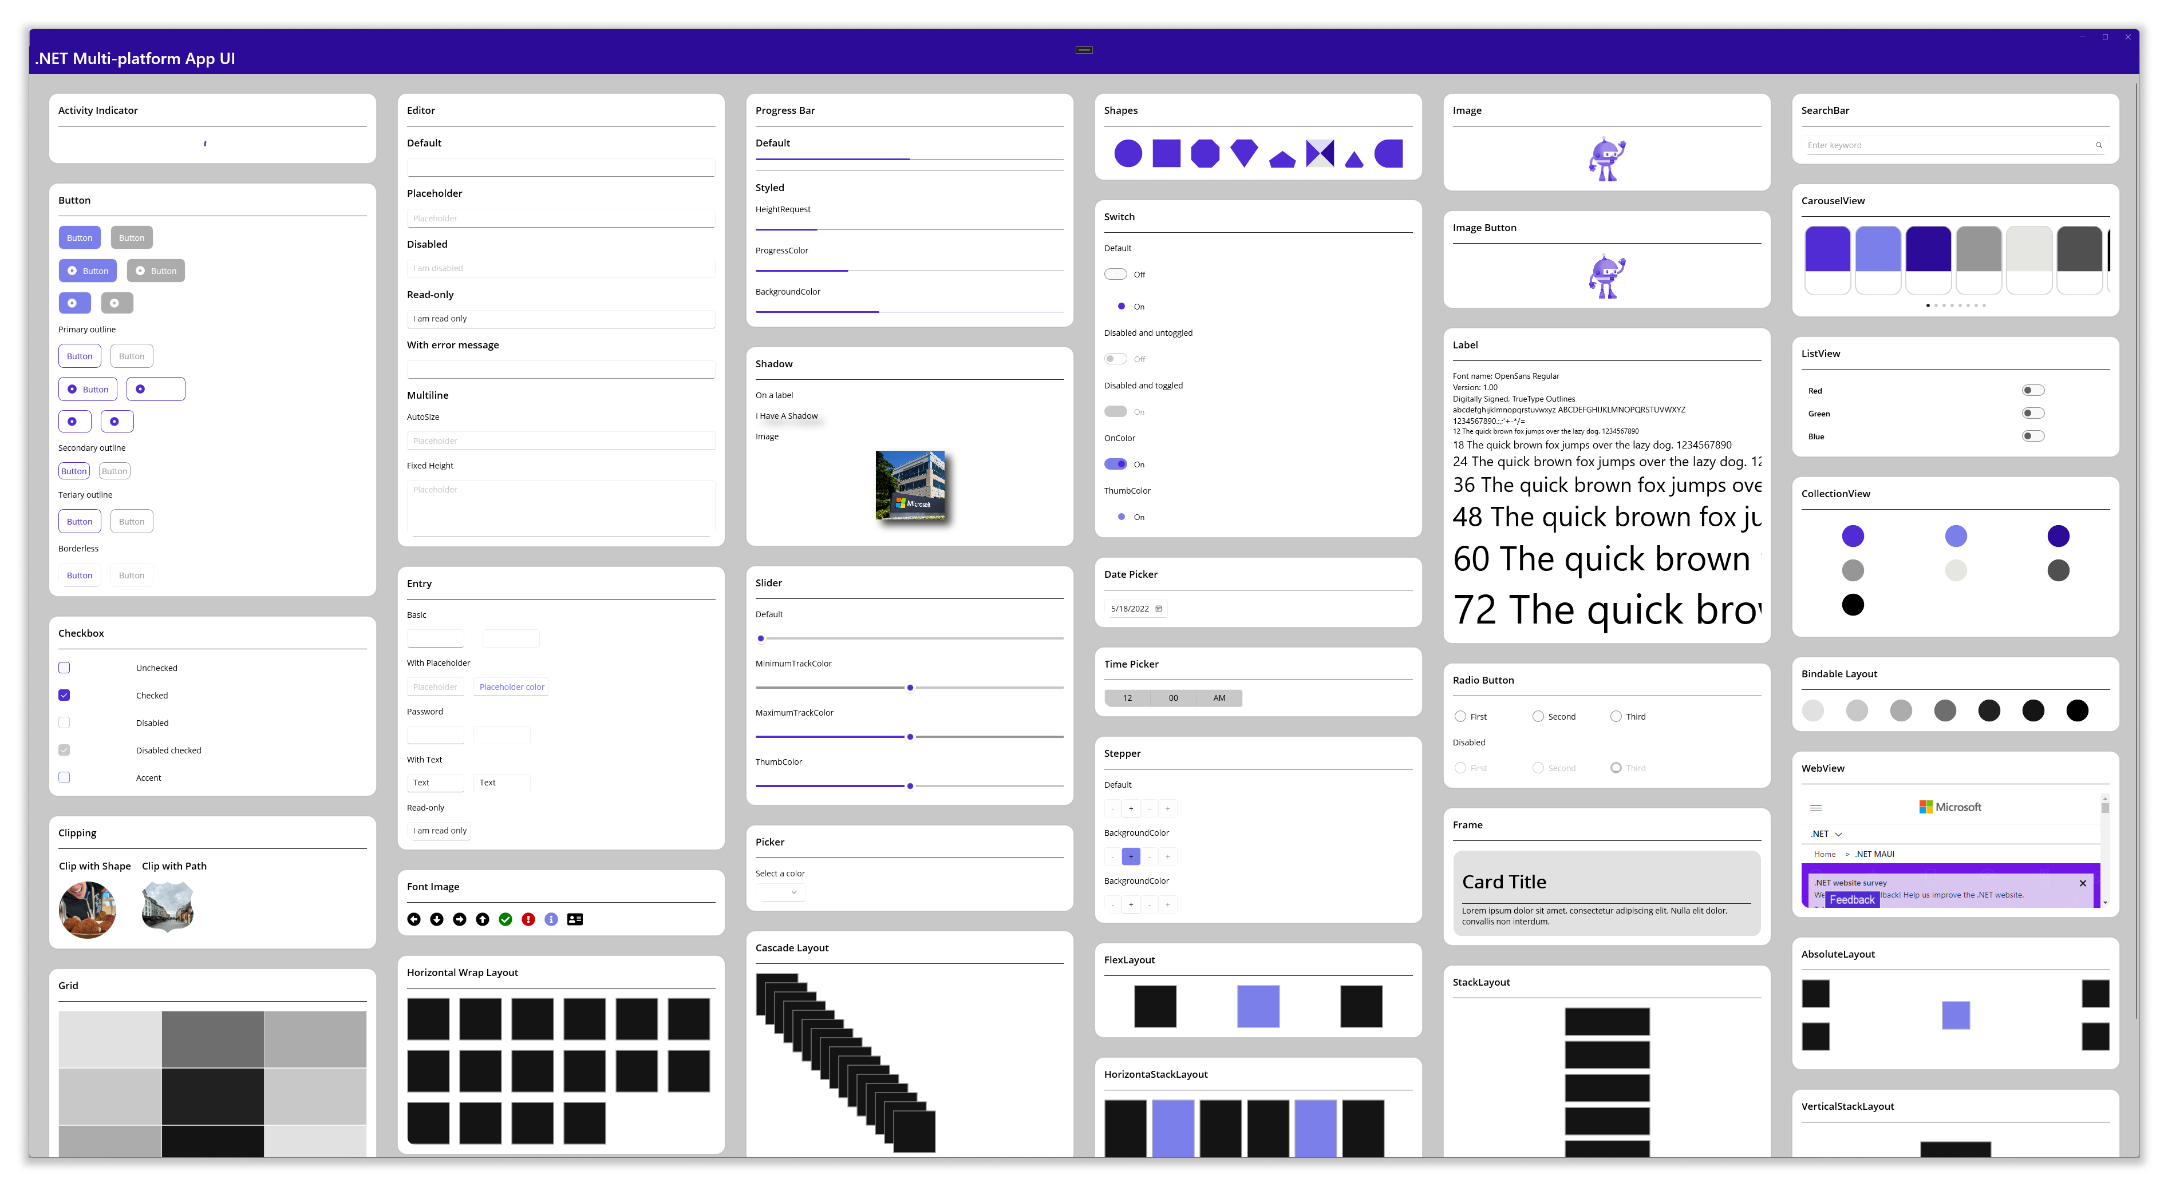
Over 50 Controls, Layouts and Views

Slide 22
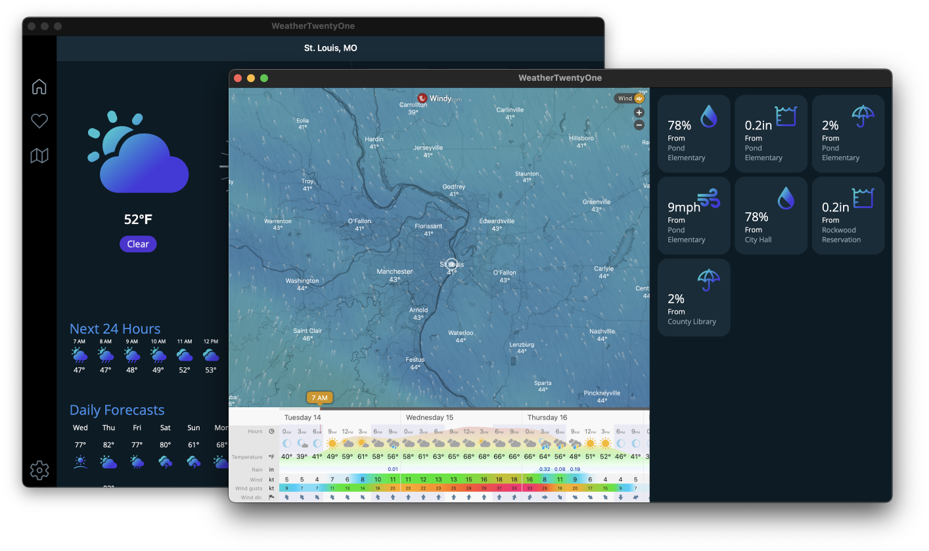
Multi-window

Slide 23
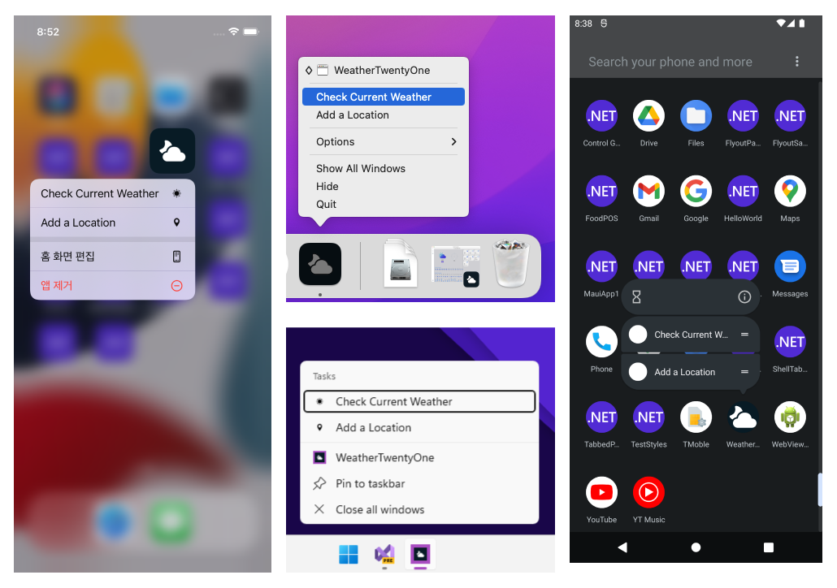
Beyond UI
Simple access to APIs
Access services and features of each platform
App actions
Clipboard
Device sensors
File system
Network
Notifications
+More

Slide 24
Demo
.NET MAUI Deep Dive
Notes:
30 min before demo
After demo. @45 min max

Slide 25

Hybrid
Bring native client capabilities to your web apps.
Notes:
[M]

Slide 26

Blazor – full stack web apps with .NET
Notes:
[M] Blazor lets you write full stack web apps with C# instead of JavaScript and it has taken the web world by storm. You can author reusable web UI components using C#, HTML and CSS and choose to run on the server or locally in the browser.
It has supported two models since spring 2020, Blazor Server, which is connected to a server, and Blazor WebAssembly which runs completely in the browser. Blazor has a shared component model across the server and the client browser. Depending on your application’s needs, you can choose the right model for you.

Slide 27
Blazor hybrid apps
Blazor
Reuse UI components across native and web
Native app container & embedded controls
Built on top of .NET Multi-platform App UI
BlazorWebview
.NET MAUI
WinUI
Mac
Catalyst
iOS
Android
macOS
iOS
Notes:
[M] With .NET MAUI, Blazor apps can now also run natively. This means you can create hybrid client apps, which combine web and native UI together in a single native client application so you can build rich client and offline experiences.
Blazor hybrid apps are built on top of .NET MAUI. You host Blazor components with the BlazorWebview which runs completely native.
Blazor hybrid relies on .NET MAUI for a native application container and native controls. Blazor hybrid apps have full access to the machine. You can do things like call native API's, access the file system, write multi-threaded applications – all with the high-performance and optimal memory consumption you get with .NET.

Slide 28
Choose your stack
BLAZOR
BLAZOR + .NET MAUI
.NET MAUI
C#, HTML, CSS
C#, XAML
Reach
Power
Site
PWA
Electron, CEF
Native App
with WebView
Native App
Web
Hybrid
Native
Notes:
[M] As you can see you have choices when it comes to native and web development with .NET. It comes down to reach and power and it’s a sliding scale. Depending on your application’s needs, you can choose the right mix for you. Fully web for the most reach, fully native for the richest native experiences, or a little bit of both with hybrid.

Slide 29
Demo
Blazor Hybrid with .NET MAUI
Notes:
[M] 48min mark
After Demo ~51
Add Blazor signature component – show where it is in codebase

Slide 30

What’s next?

Slide 31
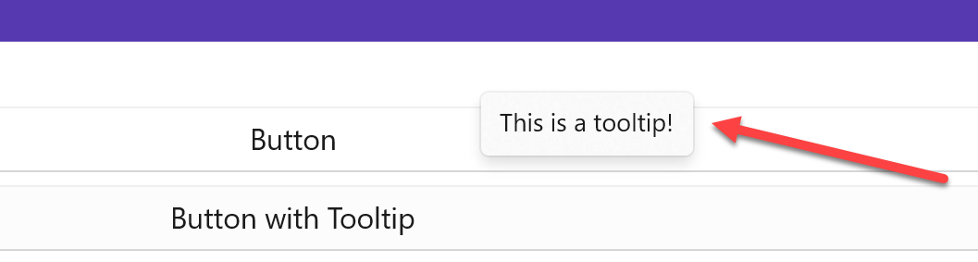
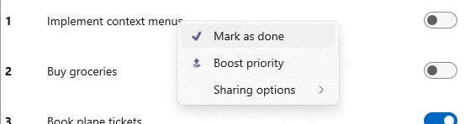
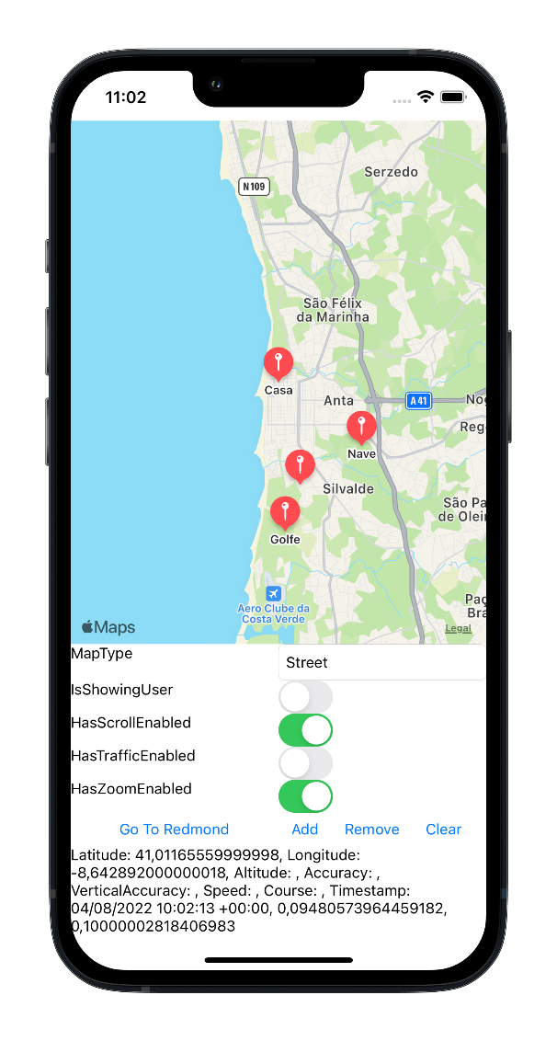
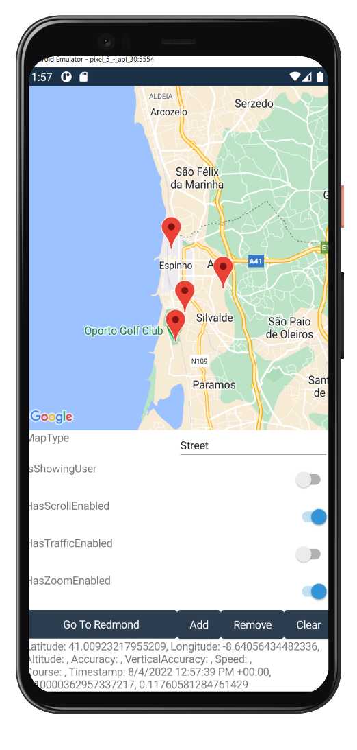
.NET 7 roadmap
.NET MAUI is great for desktop apps
Platform interop
Channels
Mobile
Maps
…and more!
ContextMenu
Cursors
Hover Gesture
Right-click Gesture
Title Bar
Tooltips

Slide 32
Release schedule, support & patching
Patches for 18 months (6 months after .NET 8 ships)
.NET MAUI
.NET 7
Nov 2022
.NET 8
Nov 2023
.NET 9
Nov 2024
14
Xcode
32, 33
Android
Xamarin
EOS May 2024
A major version of .NET MAUI will ship with .NET going forward (.NET 7, .NET 8, etc.)
.NET MAUI is an optional workload with external dependencies (such as Xcode & Android SDK tools)
A major version of .NET MAUI will receive patches for 6 months after a successor (major version) ships
Xamarin SDKs will receive support until May 2024
Notes:
.NET MAUI is governed by the Microsoft Modern Lifecycle. Here’s how it works….
CLICK
A major version of .NET MAUI will ship with .NET going forward (.NET 7, .NET 8, etc.)
CLICK
.NET MAUI is an optional workload with external dependencies such as Xcode & Android SDK tools
CLICK
Because of this, a major version of .NET MAUI will receive support and patches for 6 months after a successor ships
CLICK
Xamarin will reach end of support in May 2024, at which point we will stop patching.
The takeaway is you are always supported on the latest mobile and desktop technologies. You will find that this is the best support in the industry today.

Slide 33
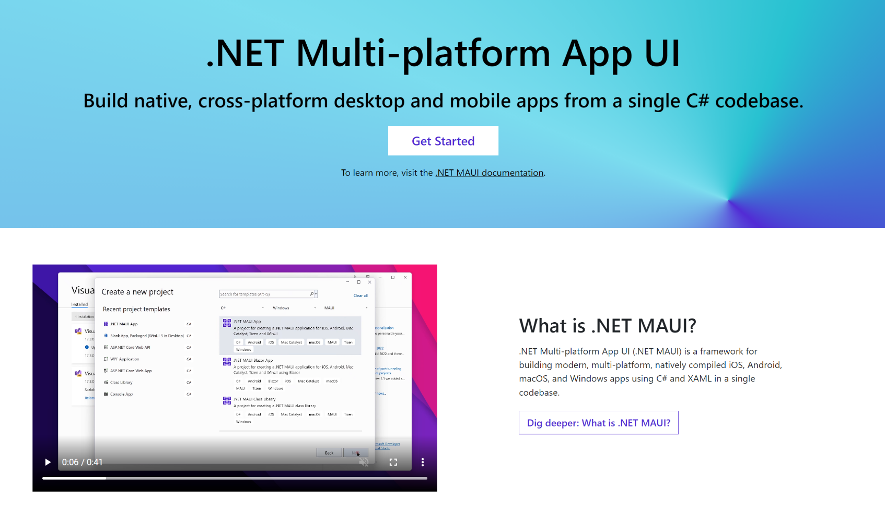
Get started today!
Get started with .NET MAUI
Download Visual Studio 2022 17.3
dot.net/maui
visualstudio.com/download

Slide 34
We want to hear from you❤️
Please take our survey and tell us your feedback. We’re listening! 👂
aka.ms/maui/survey

Slide 35

Ready to have fun?

Slide 36


.NET MAUI Coding Challenges 😎
Cloud Skills Challenge
Great for beginners, get started learning .NET MAUI and participate in some friendly competition!
aka.ms/maui/CloudChallenge
Beautiful UI Challenge
Show off your UI skills by building a beautiful .NET MAUI app!
Take a challenge and get free stickers!
aka.ms/maui/UIChallenge

Slide 37
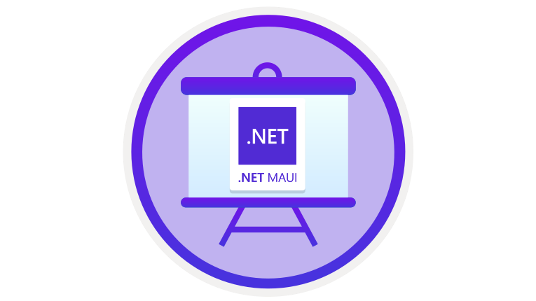
Learn Live: Build mobile and desktop apps with .NET MAUI
aka.ms/maui/learnlive
EVERY WEEK STARTING SEPTEMBER 7, 2022 THROUGH NOVEMBER 16, 2022 (7 EPISODES)

Slide 38
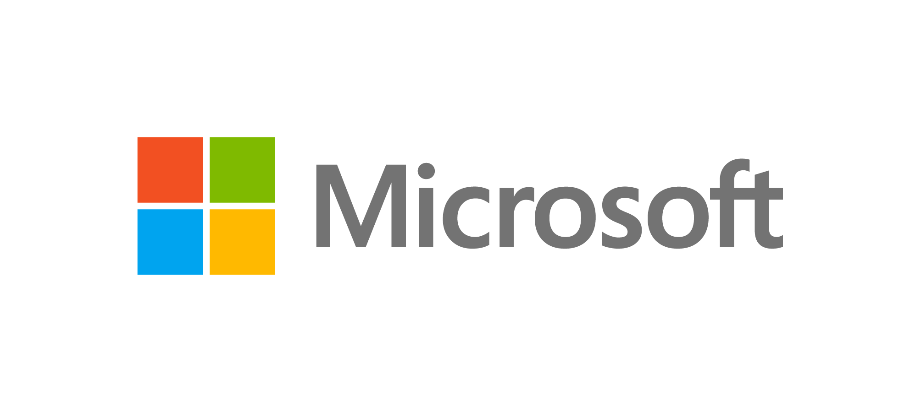







Thank you to all our sponsors 🎉
Sign up to win amazing prizes from our sponsors -> focus.dotnetconf.net/swag

Slide 39

Thanks for joining!
Ask your questions live on Twitter #dotNETConf

